Slide 1
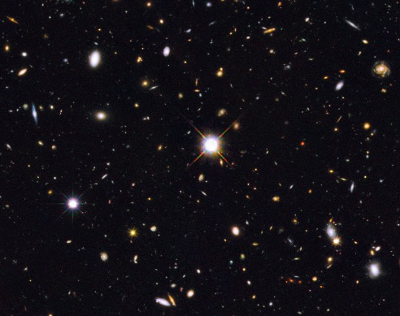
Characterizing High [OIII]/[OII] Galaxies for LyC Study
Alex Blanche
Mentors: Dr. Brent Smith, Dr. Rogier Windhorst
Arizona Space Grant Symposium
April 23th, 2022

Slide 2
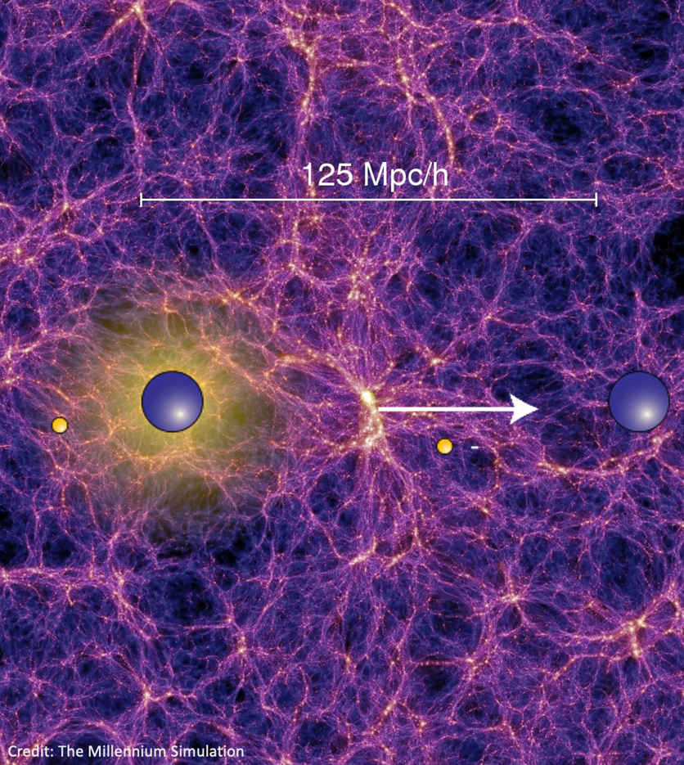

Background
The Universe is ionized
  The inter-galactic medium (IGM) is composed of low-density, ionized hydrogen
Lyman Continuum photons (LyC)
  Enough energy to ionize Hydrogen.
Galaxies that have strong [OIII] and [OII] emission lines frequently emit LyC compared to other galaxies (Fletcher et al. 2018)

Slide 3
Purpose
Data Set
Categorize and identify [OIII]/[OII] galaxies
Identify additional spectra needed to measure LyC emissions
Fit [OIII]/[OII] lines in order to calculate line flux
Redshift between 2.30 < z < 4.30
Initial 700+ spectra from GOODS-N field
Final 23 spectra with strong [OIII] or [OII] lines

Slide 4
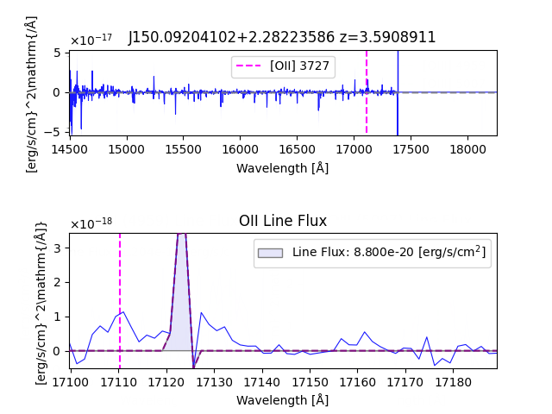
Data and Methods
Line fluxes calculated by integrating over line fits found using a Gauss–Hermite quadrature fit
Line fit was based on redshift value (z)
Stronger peaks, well defined from noise showed better line fits and therefore more accurate line fluxes.

Slide 5
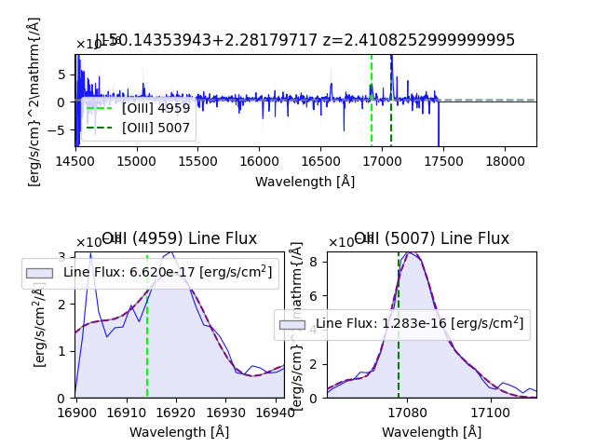
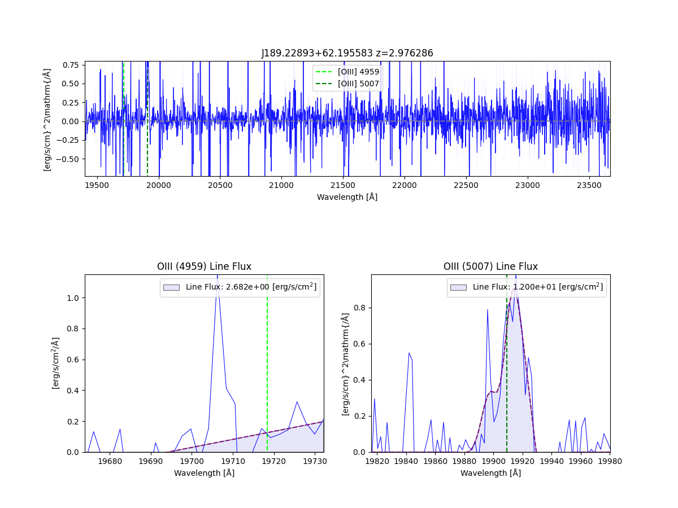

Slide 6
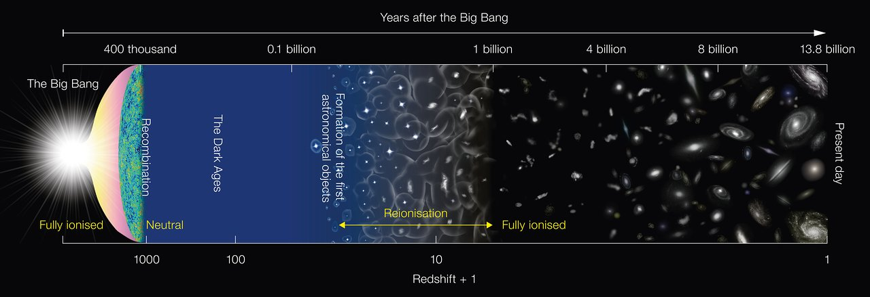
Credit: NAOJ
Notes:
What objects reionized and how?

Slide 7
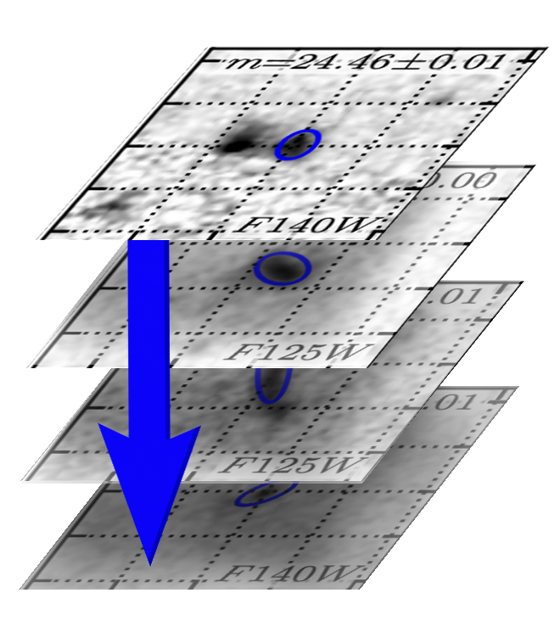
Future Work
Measuring LyC from the HST UV images and spectra
Stack image cutouts from strong and weak [OIII]/[OII] galaxies

Slide 8
Thank You
Special thanks to my mentors
Dr. Smith and Dr. Windhorst and to the UVCANDELS team

